Slide 1
IST659 Data Admin Concepts and Database Management
SQL II
week 7

Slide 2
Acknowledgements and caveat
These course materials draw liberally, with permission, from the following sources:
IST659 classes taught by Prof. Bei Yu
IST659 classes taught by Prof. Susan Dischiave
IST 659 classes taught by Prof. Yun Huang
Instructor resources provided by our text book ”Modern Database Management”
Caveat (beware): At best, PowerPoint slides are only a pale imitation of the entirety of a class meeting. In IST659 in particular, the lectures will cover topics beyond what appears in these slides. Don’t rely on them as a substitute for attending class.

Slide 3
SQL Review
Create Schema & Populate Tables

Slide 4
SQL Server log in
Open SQL Server Management Studio 2018
Server name: ist-s-students.syr.edu
Select Windows Authentication
Click Connect

Slide 5
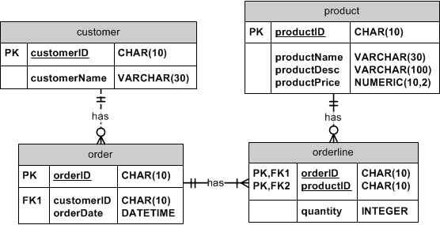
Example: furniture order

Slide 6
SQL I Review
Create and populate tables in appropriate order
Create (strong) entities without FKs first
If an entity has a foreign key that references a parent table, create the parent table first.
Populate entities without FKs first
Referential integrity check
Follow the same order to populate the tables
Follow the reverse order to delete the records and drop tables

Slide 7
Reminder
Do not use system-reserved keywords to name your table and attributes
Can you create a table named “order”?
Best Practice
Upper case all the keywords
When populating tables, pay attention to the foreign key values

Slide 8
Exercise from last week

Slide 9
Exercise
Implement the following data model
Create the tables
Populate 5 rows in each table

Slide 10
More
How to check your table definition
sp_help ‘tablename’
Add constraint
To create a FOREIGN KEY constraint on the "P_Id" column when the "Orders" table is already created, use
ALTER TABLE Orders ADD CONSTRAINT fk_PerOrders FOREIGN KEY (P_Id) REFERENCES Persons(P_Id)
Drop a constraint
ALTER TABLE Orders DROP CONSTRAINT fk_PerOrders
Insert multiple records in one sql command
INSERT INTO tableName (column1, column2)
VALUES ( val11, val12), ( val21, val22);
Notes:
Alter table can change/add/drop columns and add/drop constraints. E.g., can change a column’s data type with some limitations.

Slide 11
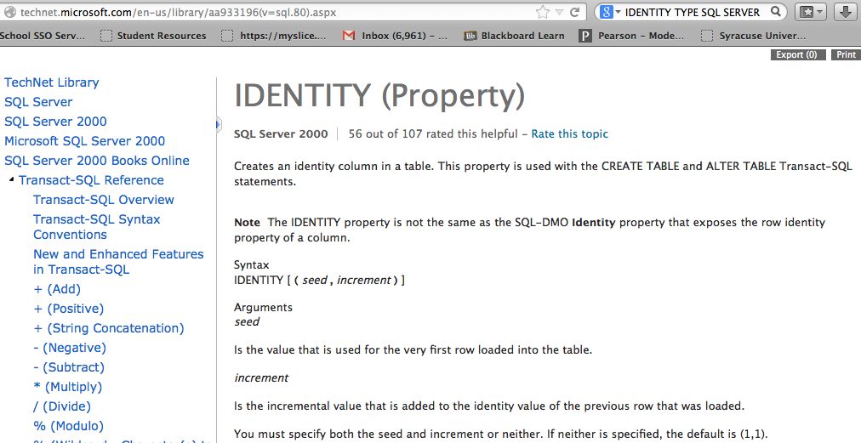
IDENTITY
CREATE TABLE student
(
studentID INT IDENTITY (1000, 1) ,
…..
)

Slide 12
SQL
Last week (week 6)
Create/drop table, insert values
This week (week 7)
Alter table, delete and update values
Single-table select
Aggregate functions to answer data questions
Next week
Multi-table query
Nested query

Slide 13
SQL
UPDATE, DROP, SELECT Clauses

Slide 14
DROP tables
DROP TABLE statement allows you to remove tables from your schema:
DROP TABLE CUSTOMER_T
The order of dropping table
You can’t drop the strong tables without dropping the weak tables first

Slide 15
ALTER table, UPDATE values
Drop the 4 tables created last time
Think about the sequence of deletion
Run Week7-SQL-DDL.sql to create and populate tables
Open “IST659-SQL-II.sql”

Slide 16
DELET Statement
Removes rows from a table
Delete certain rows
DELETE FROM CUSTOMER_T WHERE STATE = ‘HI’;
Delete all rows
DELETE FROM CUSTOMER_T;

Slide 17
SELECT statement
Used for queries on single or multiple tables
Clauses of the SELECT statement:
SELECT
List the columns (and expressions) that should be returned from the query
FROM
Indicate the table(s) or view(s) from which data will be obtained
WHERE
Indicate the conditions under which a row will be included in the result
GROUP BY
Indicate categorization of results
HAVING
Indicate the conditions under which a category (group) will be included
ORDER BY
Sorts the result according to specified criteria

Slide 18
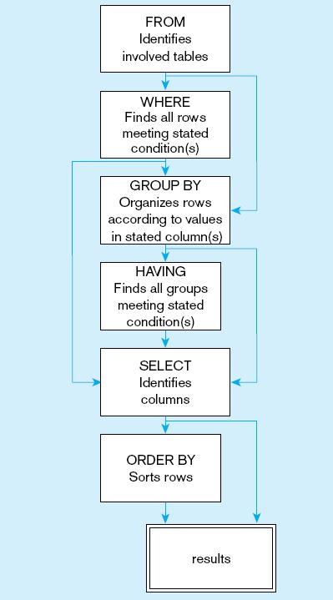
http://msdn.microsoft.com/en-us/library/h09t6a82(v=vs.80).aspx
Notes:
Examples of group by: organize sales by states, organize student performance by social groups

Slide 19
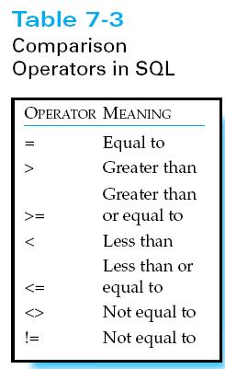
SELECT statement
Find products with price less than $275
SELECT * FROM product WHERE price<275
SELECT productID FROM product WHERE price<275

Slide 20
GET HANDS DIRTY
Use script “IST659-SQL-furnitureOrder-SELECT.sql”
Create tables (script line #1-52)
Create tables in order
IDENTITY type in SQL Server (AUTONUMBER in Access)
Insert values (script line #54-81)
Insert into tables in order
No need to input values for columns with identity data type
Check customerOrder table for the values

Slide 21
SELECT example
Query: find products with standard price less than $275 (script line #84)
Notes:
Write an empty query
Select
From
Where
Group by
Having
Order by

Slide 22
SELECT example
Query: find products with standard price less than $275 (script line #84)
Where are the prices? In the product table!
Product_id | Product_name | Product_finish | Standard_price | Product_line_id
1 | End Table | Cherry | $175 | 1
2 | Coffee Table | Natural Ash | $400 | 2
3 | Computer Desk | Natural Ash | $175 | 2
4 | Dining Table | Natural Ash | $800 | 3
5 | Computer Desk | Walnut | $250 | 1

Slide 23
SELECT example
Query: find products with standard price less than $275 (script line #84)
Which rows to select? standardPrice<275
Product_id | Product_name | Product_finish | Standard_price | Product_line_id
1 | End Table | Cherry | $175 | 1
2 | Coffee Table | Natural Ash | $400 | 2
3 | Computer Desk | Natural Ash | $175 | 2
4 | Dining Table | Natural Ash | $800 | 3
5 | Computer Desk | Walnut | $250 | 1

Slide 24
The “select” clause
Query: find products with standard price less than $275 (script line #84)
Which columns to select? All of them!
SELECT *
FROM product
WHERE standardPrice < 275;

Slide 25
The “select” clause
Query: find products with standard price less than $275 (script line #84)
Which columns to select? All of them!
SELECT *
FROM product
WHERE standardPrice < 275;
productID | productDesc | productFinish | standardPrice
1 | End Table | Cherry | $175
3 | Computer Desk | Natural Ash | $175
5 | Computer Desk | Walnut | $250

Slide 26
The “select” clause
Query: find products with standard price less than $275
Just need product description and price?
SELECT productDesc, standardPrice
FROM product
WHERE standardPrice < 275;
productDesc | standardPrice
End Table | $175
Computer Desk | $175
Computer Desk | $250

Slide 27
The “select” clause
Query: find products with standard price less than $275
Just need product description?
Duplicate descriptions?
SELECT productDesc
FROM product
WHERE standardPrice < 275;
productDesc
End Table
Computer Desk
Computer Desk

Slide 28
The “select” clause
Query: find products with standard price less than $275
SELECT DISTINCT productDesc
FROM product
WHERE standardPrice< 275;
productDesc
End Table
Computer Desk

Slide 29
The “WHERE” clause
Number comparison operators
>, >=, <, <=, =, <>
String match operators
%, _
Set operators
IN, NOT
Boolean operators
AND, OR, NOT

Slide 30
Matching a substring using “%”
SELECT productDesc
FROM product
WHERE productDesc LIKE “%Table”;
productDesc
Coffee Table
Dining Table
Script line # 128-130
Notes:
LIKE is match patterns. The "%" sign is used to define wildcards (missing letters) both before and after the pattern.
Wildcard Description
% A substitute for zero or more characters
_ A substitute for a single character
[charlist] Sets and ranges of characters to match
[^charlist]
or
[!charlist] Matches only a character NOT specified within the brackets

Slide 31
Matching a character using “_”
SELECT customerFName, customerLName FROM customer WHERE customerLName LIKE '_elly';
customerFName customerLName
Abe Kelly

Slide 32
Boolean operators
AND, OR, NOT
Boolean operators are used to combine multiple conditions in the “where” clause
Order of boolean operations
“NOT” first, “AND” second, “OR” has the lowest priority
Analogy to arithmetic operators -, *, and +
NOT is like “negative”, e.g. -7, AND is like multiplication “*”, OR is like addition “+”
1+2*3=7, x OR y AND z
(1+2)*3=9, (x OR y) AND z

Slide 33
SELECT using Boolean operators
SELECT productDesc, productFinish, standardPrice
FROM product
WHERE (productDesc LIKE ‘%Desk’ OR productDesc LIKE ‘%Table’);
productID | productDesc | productFinish | standardPrice
1 | End Table | Cherry | $175
2 | Coffee Table | Natural Ash | $400
3 | Computer Desk | Natural Ash | $175
4 | Dining Table | Natural Ash | $800
5 | Computer Desk | Walnut | $250

Slide 34
SELECT using Boolean operators
SELECT productDesc, productFinish, standardPrice
FROM product
WHERE (productDesc LIKE ‘%Desk’
OR productDesc LIKE ‘%Table’)
AND standardPrice > 200;
productDesc | productFinish | standardPrice
Coffee Table | Natural Ash | $400
Dining Table | Natural Ash | $800
Computer Desk | Walnut | $250

Slide 35
SELECT using ranges
SELECT productID, productDesc, standardPrice;
FROM product
WHERE standardPrice BETWEEN 200 AND 500;
productID | productDesc | productFinish | standardPrice
1 | End Table | Cherry | $175
2 | Coffee Table | Natural Ash | $400
3 | Computer Desk | Natural Ash | $175
4 | Dining Table | Natural Ash | $800
5 | Computer Desk | Walnut | $250

Slide 36
SELECT using ranges
Product_name | Product_finish | Standard_price
Coffee Table | Natural Ash | $400
Computer Desk | Walnut | $250

Slide 37
SELECT using sets of values
SELECT customerID, customerFName, customerLName, customerState
FROM customer
WHERE customerState IN (‘FL’, ‘TX’, ‘CA’, ‘HI’);

Slide 38
SELECT using sets of values
SELECT customerID, customerFName, customerLName, customerState
FROM customer
WHERE customerState NOT IN (‘FL’, ‘TX’, ‘CA’, ‘HI’);

Slide 39
Same tricks for update and delete
Using comparing operators
Using range operators
Using wildcards “%” and “_”
Using boolean operators AND, OR, NOT
Using sets of values (IN, NOT IN)

Slide 40
Sorting results
Sort customers by their states and lastnames

Slide 41
Sorting results
Sort customers by their states and lastnames
SELECT customerFName, customerLName, customerState
FROM customer
WHERE customerState IN (‘FL’, ‘TX’, ‘CA’, ‘HI’)
ORDER BY customerState, customerLName;

Slide 42
SELECT TOP clause
When TOP is used in conjunction with the ORDER BY clause, the result set is limited to the first N number of ordered rows; otherwise, it returns the first N number of rows in an undefined order.
SELECT TOP 32 WITH TIES productID
FROM orderline
ORDER BY quantity;

Slide 43
Aggregation functions
COUNT
SUM
MIN
MAX
AVG

Slide 44
COUNT
Data question: how many customers are from California?
Answer by executing this query
Select count(customerID) from customer where customerState = ‘CA’;

Slide 45
COUNT exercise
Data question: how many unique items were ordered in Order#1004?
orderID | productID | quantity
1001 | 1 | 2
1001 | 2 | 2
1001 | 4 | 1
1002 | 3 | 5
1003 | 3 | 3
1004 | 5 | 2
1004 | 4 | 2
1005 | 4 | 4

Slide 46
COUNT exercise
SELECT COUNT(*)
FROM orderline
WHERE orderID=1004;
Order_ID | Product_ID | quantity
1001 | 1 | 2
1001 | 2 | 2
1001 | 4 | 1
1002 | 3 | 5
1003 | 3 | 3
1004 | 5 | 2
1004 | 4 | 2
1005 | 4 | 4

Slide 47
COUNT exercise
COUNT(*)
2
Order_ID | Product_ID | quantity
1001 | 1 | 2
1001 | 2 | 2
1001 | 4 | 1
1002 | 3 | 5
1003 | 3 | 3
1004 | 5 | 2
1004 | 4 | 2
1005 | 4 | 4

Slide 48
MIN, MAX, and AVG
Data question: what is the lowest price?
SELECT MIN(standardPrice)
FROM product;

Slide 49
MIN, MAX, and AVG
Data question: what is the highest price?
SELECT MAX(standardPrice)
FROM product;

Slide 50
MIN, MAX, and AVG
Data question: what is the average price?
SELECT AVG(standardPrice)
FROM product;

Slide 51
SUM
Data question: how many pieces of furniture ordered in total in order#1004?
Answer: 2+2=4
Order_ID | Product_ID | quantity
1001 | 1 | 2
1001 | 2 | 2
1001 | 4 | 1
1002 | 3 | 5
1003 | 3 | 3
1004 | 5 | 2
1004 | 4 | 2
1005 | 4 | 4

Slide 52
SUM
SELECT SUM(quantity)
FROM orderline
WHERE orderID=1004
SUM(quantity)
4

Slide 53
More on aggregation
Aggregate functions ignore null values
Aggregate functions can be combined with distinct values
/* Compare these two statements, see script line#154 */
SELECT COUNT(DISTINCT customerID)
FROM customerOrder;
SELECT COUNT( customerID)
FROM customerOrder;

Slide 54
GROUP BY: data categorization
Goal: generate a report to list the number of customers in each state
Process:
find all customer records in the customer table
Categorize them into groups by customerState
Count the number of customers in each group
Output the result

Slide 55
GROUP BY: data categorization
/* group by always uses together with aggregation functions
/* query: how many customers in California? */
select count(customerID) 'total number of customers' from customer where customerState='CA';
/* query: how many customers in each state? */
select count(customerID) 'total number of customers' from customer group by customerState;
/* better readability*/
select customerState, count(customerID) 'total number of customers' from customer
group by customerState;

Slide 56
GROUP BY exercise
/* query: how many pieces are sold for each product? */

Slide 57
GROUP BY exercise
/* query: how many pieces are sold for each product? */
/* for a specific product */
select sum(quantity) 'total quantity sold'
from orderline
where productID=1;
/* for all products */
select productID, sum(quantity) 'total quantity sold'
from orderline
group by productID;
/* top 5 best sellers*/
select TOP 5 productID, sum(quantity) 'total quantity sold'
from orderline
group by productID
Order by sum(quantity) DESC;

Slide 58
HAVING: selecting groups
/* find all states with more than 1 customer, output the customer count */
select customerState, count(customerID) 'total number of customers'
from customer
group by customerState
having count(customerID)>1;

Slide 59
Aggregate and HAVING
If we use GROUP BY in a SQL statement, we can only select columns that are either listed in the GROUP BY clause or in an aggregate function.
The same rule applies for columns in the HAVING clause.

Slide 60
HAVING exercise
/* find all states with warm weather, output the customer count */

Slide 61
HAVING exercise
/* find all states with warm weather, output the customer count */
select customerState, count(customerID) 'total number of customers'
from customer
group by customerState
having customerState IN ('CA', 'TX');

Slide 62
Select statement summary
Used for queries on single or multiple tables
Clauses of the SELECT statement:
SELECT
List the columns (and expressions) that should be returned from the query
FROM
Indicate the table(s) or view(s) from which data will be obtained
WHERE
Indicate the conditions under which a row will be included in the result
GROUP BY
Indicate categorization of results
HAVING
Indicate the conditions under which a category (group) will be included
ORDER BY
Sorts the result according to specified criteria

Slide 64
SELECT example using alias
SELECT
c.customerID ‘Customer ID’, c.customerFName ‘First Name’,
c.customerLName ‘Last Name’
FROM customer AS c
WHERE customerID= 1000000001;
Script line #94-99

